Slide 1

Santosh Kumar Kar,
skkar.2k2@gmail.com

Slide 2
CHAPTER – 2
Spring Starter Web

Slide 3
Rest Controller
@RestController
@Mapping
@GetMapping
@PostMapping
@PutMapping
@DeleteMapping

Slide 4
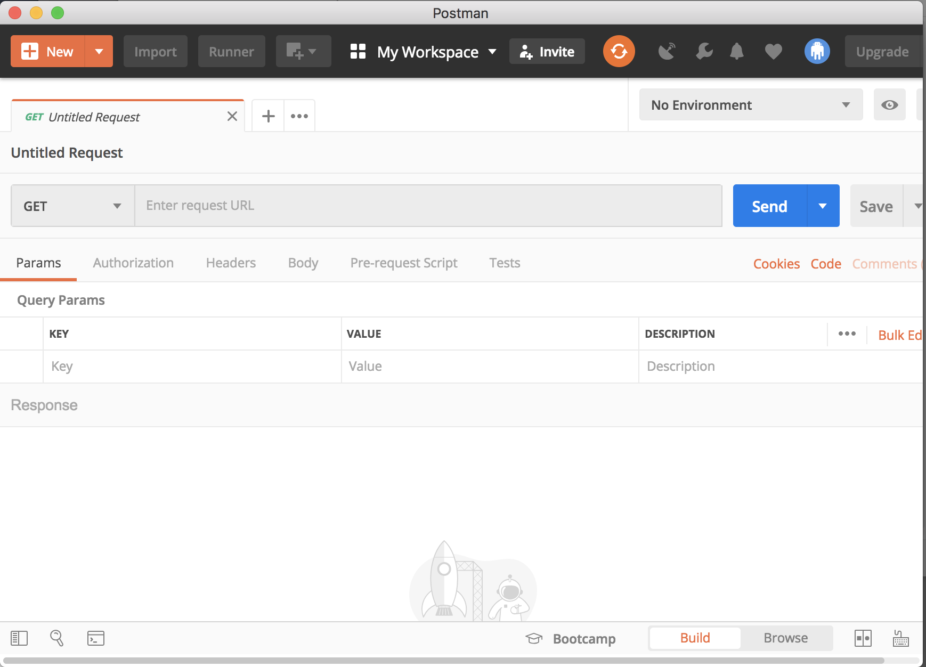

Rest Client (Postman)

Slide 5

Questions
Send to skkar.2k2@gmail.com

